Slide 1
TRANSLATOR APP
Aathira Dineshan & Jishnu Ganesh

Slide 2
Features
Translates the word to 39 languages.
Watson SDK and API for translating
Language Translator API
Speech-to-Text API
Text-to-Speech API
Database stores words you choose to be referred later.
Database can be cleared after the words are referred .

Slide 3
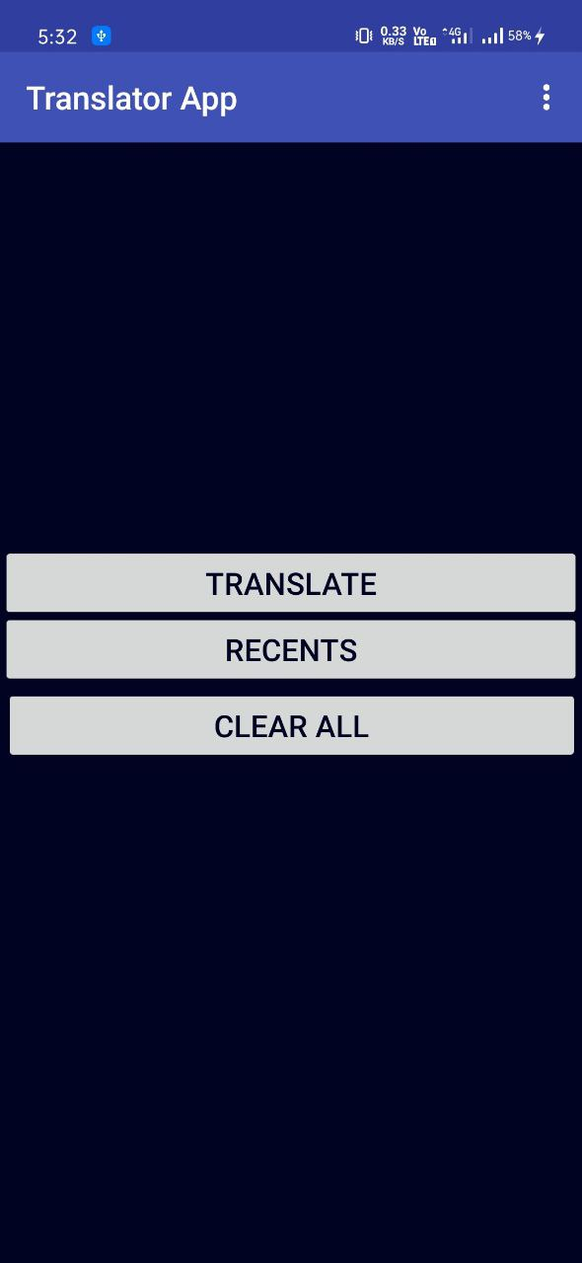
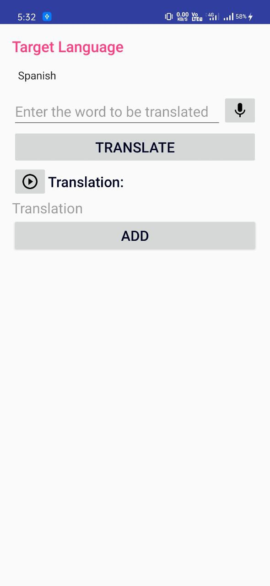
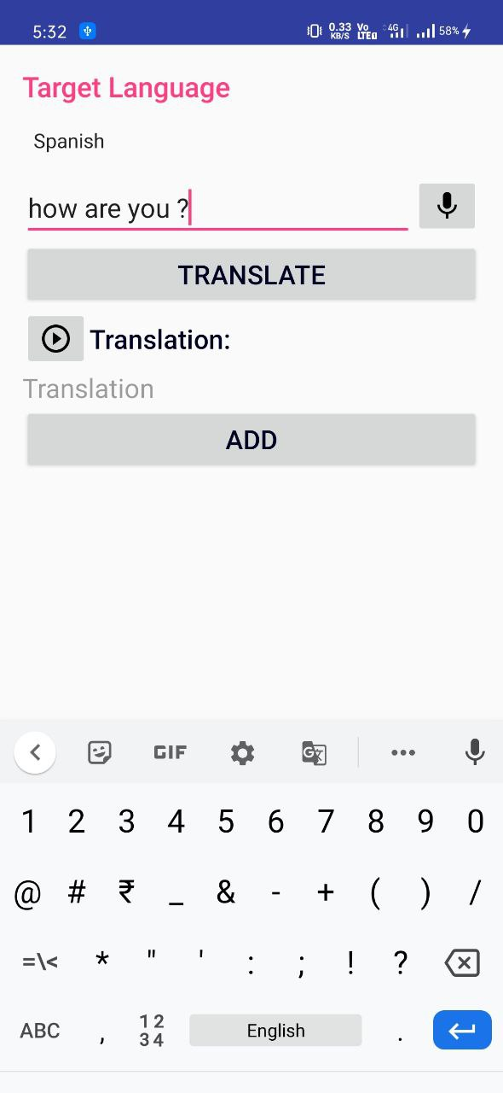
Screens
On Clicking TRANSLATE

Slide 4
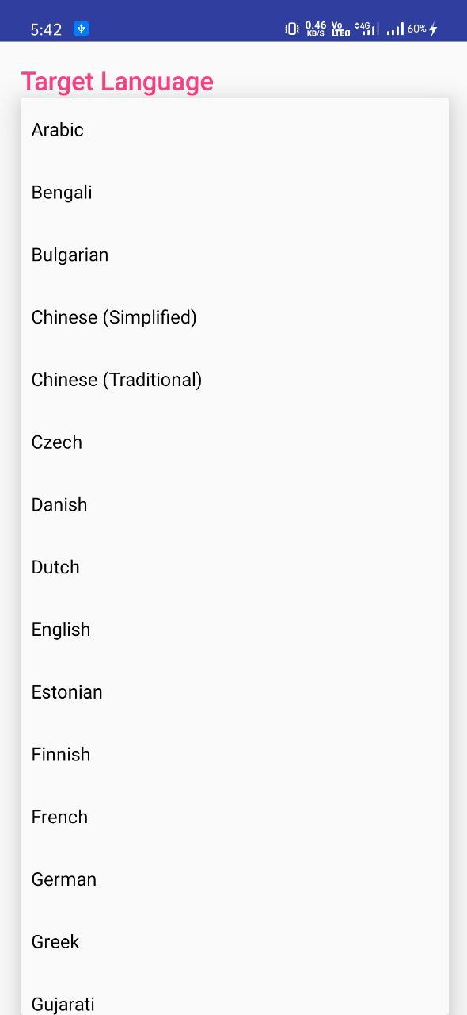
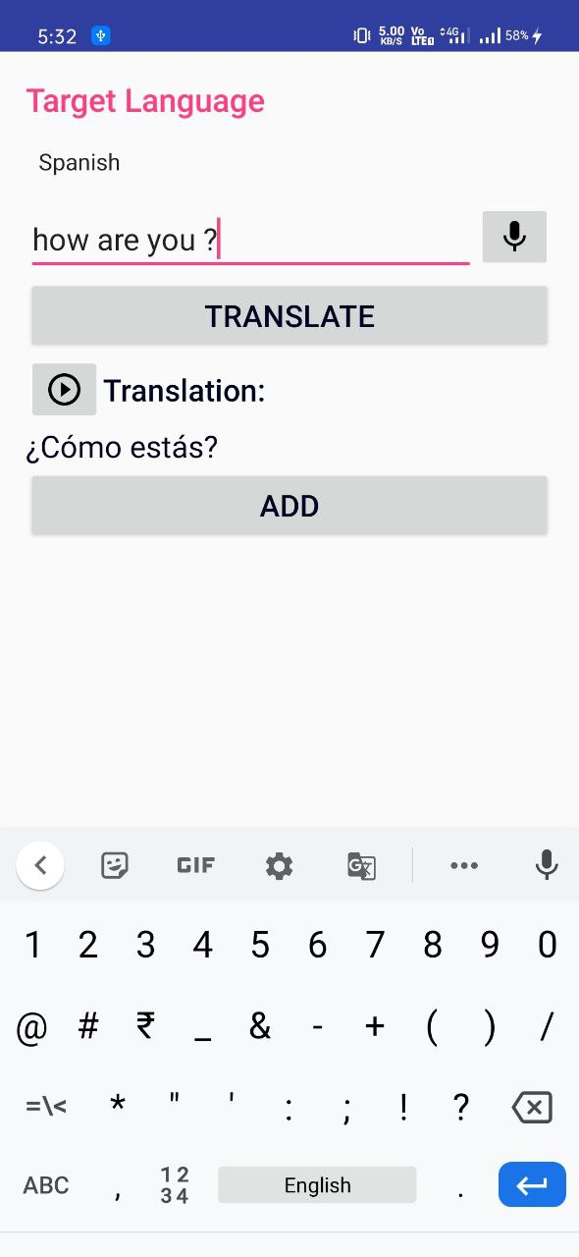
Target language selection through spinner

Slide 5
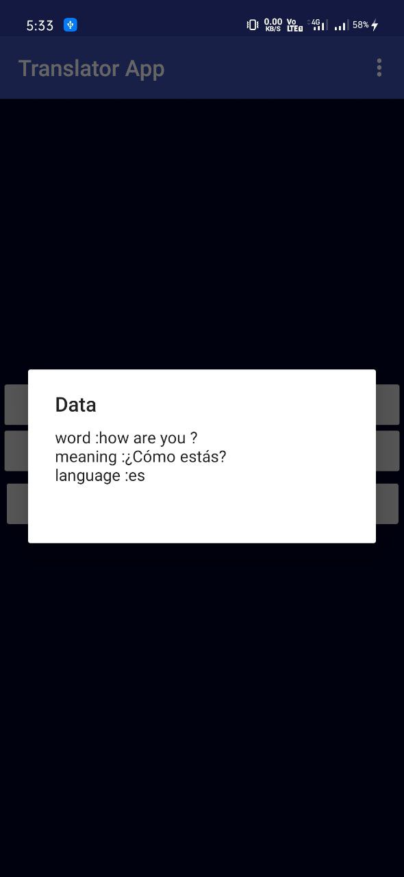
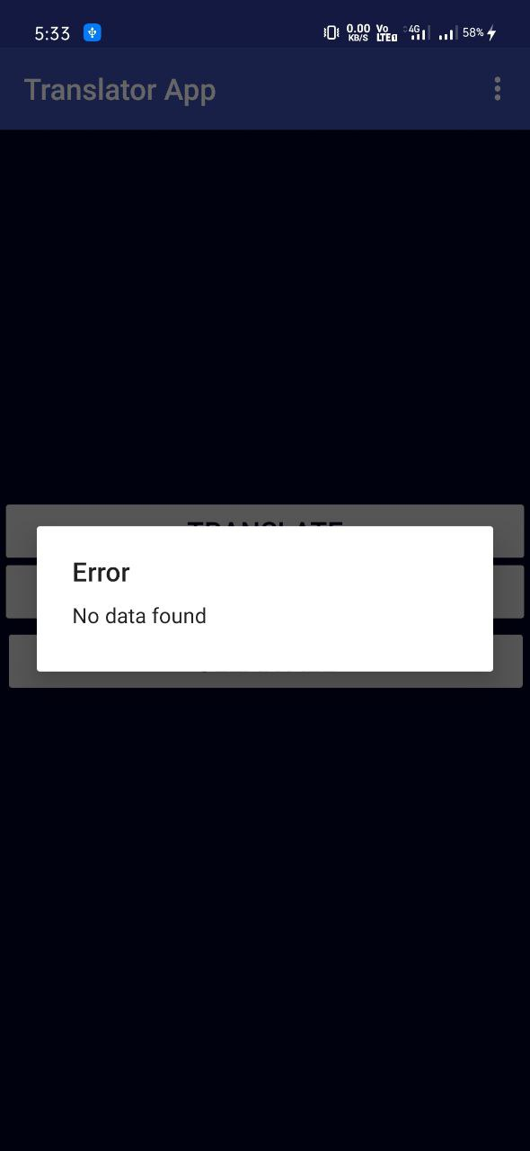
On Clicking RECENTS
On Clicking CLEAR ALL

Slide 6
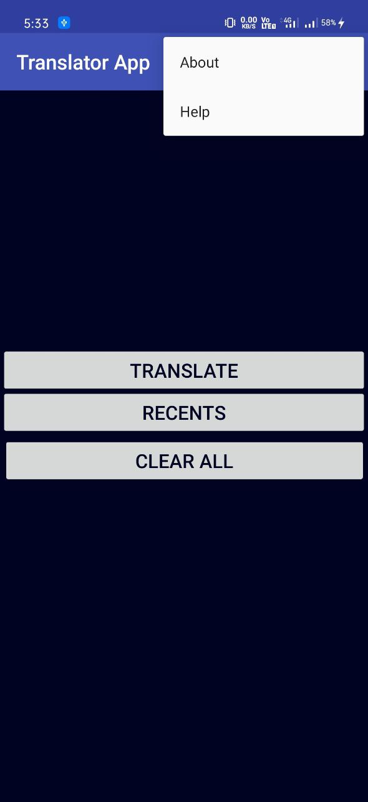
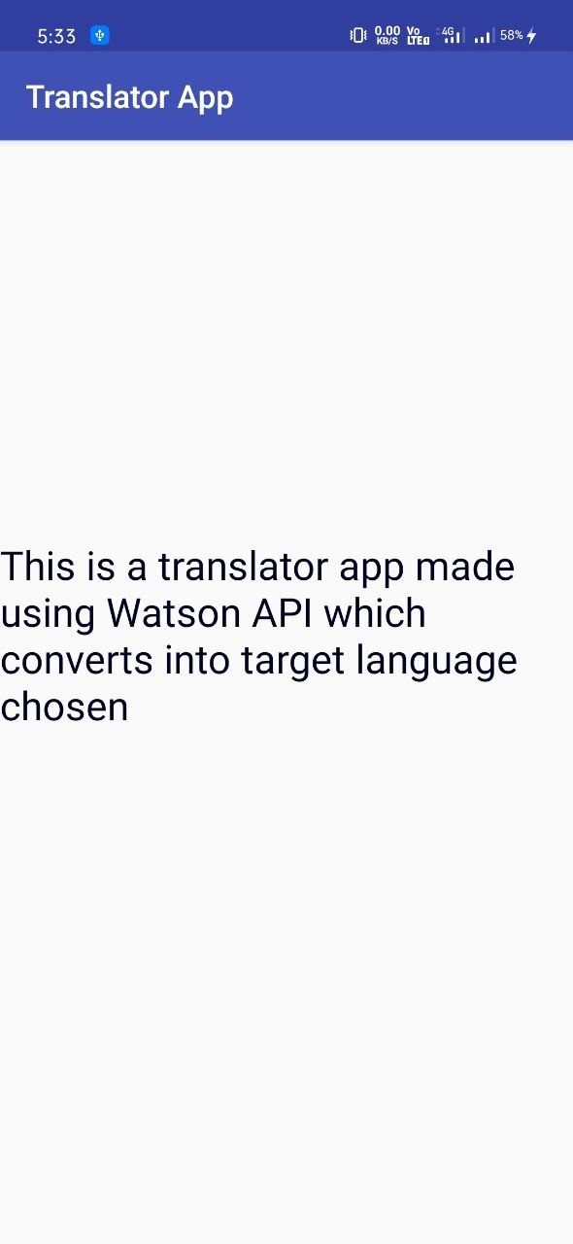
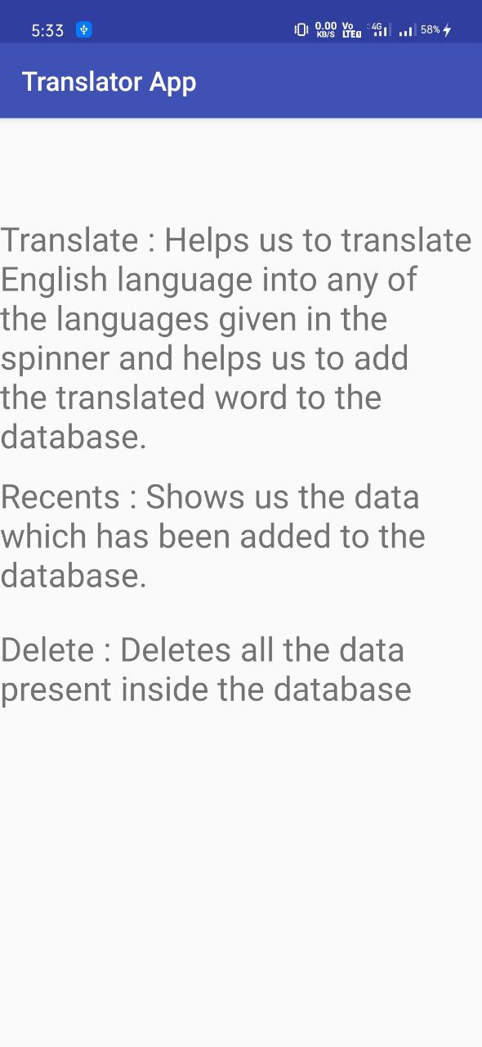
About
Help

Slide 7
Thank You

